Slide 1
APPLICATION FOR GROCERY DELIVERY

Slide 2

Introduction
This Software Requirements Specification (SRS) report outlines the requirements for a grocery delivary application. The purpose of this application is to provide a user-friendly interface for customers to browse and purchase grocery products online.
Overview:
The grocery delivery application is a web-based system designed to allow users to order groceries online and have them delivered to their doorstep. The system will allow customers to browse through the available products, add items to their cart, and complete the order process online. The application will also allow users to track their orders and get updates on their delivery status. The system will have two main user types: customers and administrators.

Slide 3
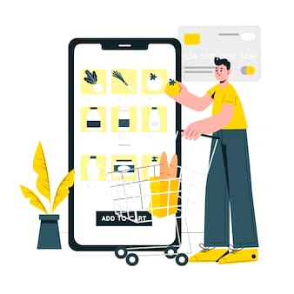
Customers & Platform
Customers:
The target audience for this application is anyone who wants to purchase grocery products online. Customers will be able to create accounts, search for products by category, view product details, add products to their cart, checkout, and make payments. Customers will also be able to view their order history and track the status of their current orders.
Platform:
The grocery delivery application will be developed as a web-based application using HTML, CSS, JavaScript, and a server-side programming language such as PHP or Python. The application will be hosted on a cloud-based server and will be accessible through a web browser on any device with an internet connection.

Slide 4
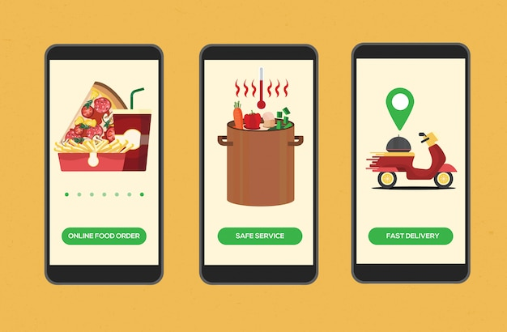
Functionality
The following are the core functionalities of the grocery delivery application:
User authentication and authorization
Grocery Product search and browsing
Grocery Product catelog and reviews
Shopping cart management
Order management and tracking
Payment management
Checkout.

Slide 5
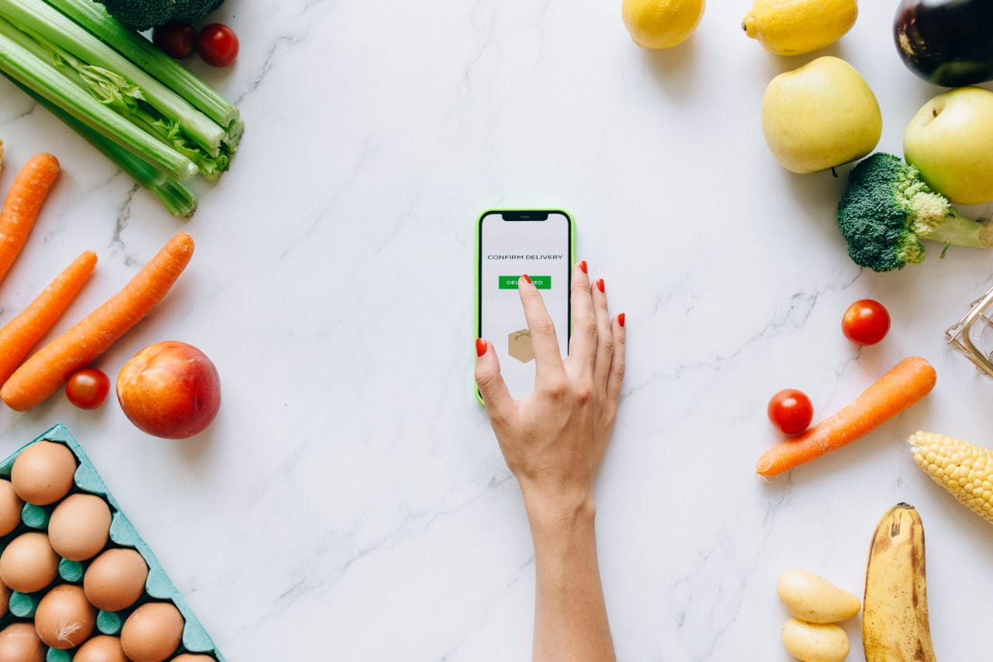
Development & Responsibility
Development & Responsibility:
The development team responsible for building the grocery delivery application will consist of a project manager, front-end developer, back-end developer, database administrator, and quality assurance tester. The project manager will be responsible for overall project management, while the front-end developer will be responsible for designing and execution user interface . The back-end developer will be responsible for implementing the business logic and combining the systems performance from order placing to payment an d trackinng. The database administrator will be responsible for designing and managing the database, while the quality assurance tester will be responsible for testing the application to ensure it meets the specified requirements.

Slide 6
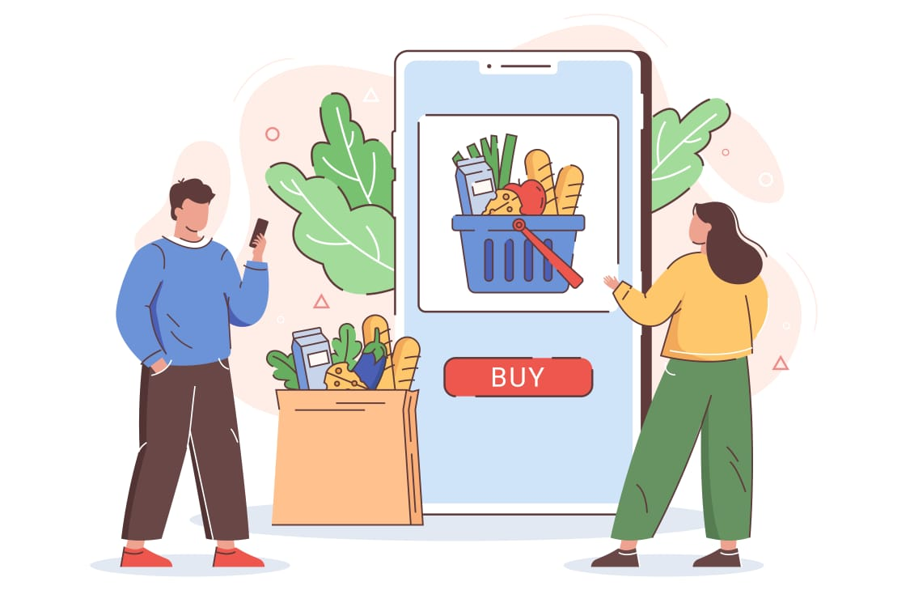
Scopes and Goals:
The scope of the grocery delivery application includes the following goals:
Create a user-friendly interface for customers to browse and purchase grocery products online
Implement a robust and secure authentication and authorization system without any issues.
Integrate with popular payment gateways for reliable and safer payments.
Provide an admin interface for managing grocery products, orders, and customers

Slide 7
Deliverables:
The following are the deliverables for the grocery delivery application:
User Interface (UI) Design
Application code
Database schema
Test cases and test results
User and technical documentation

Slide 8
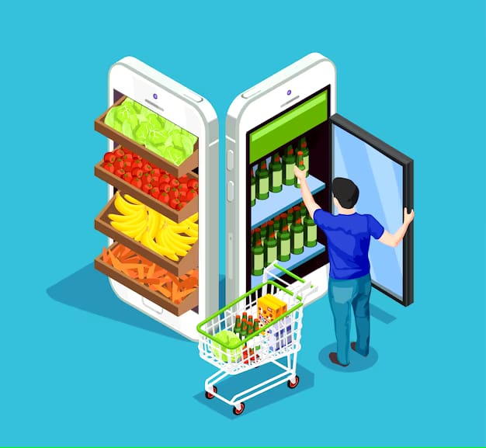
Risk Management:
The following risks have been identified for the grocery delivery application application:
Security risks such as data breaches and hacking attempts of the application.
Payment processing delays,failures,and disputes
Technical failures such as server downtime and database corruption.

Slide 9
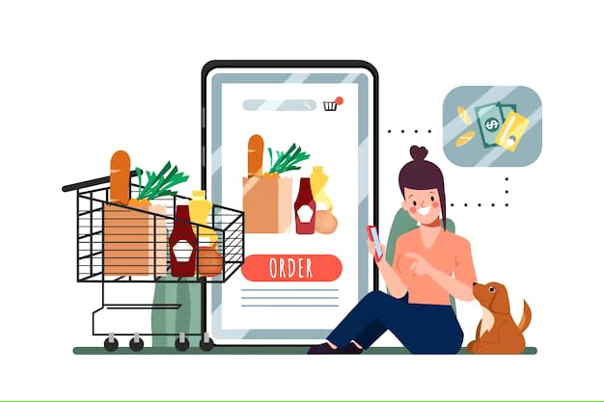
Risk Mitigation
Risk Mitigation:
The following strategies will be used to mitigate the identified risks:
Implement secure coding practices and regularly update security measures to prevent data breaches and hacking attempts
Work with reputable payment gateway providers and implement fraud detection and prevention measures to reduce the risk of payment processing failures and disputes
Implement a disaster recovery plan and regularly backup data to prevent technical failures such as server downtime and database corruption.

Slide 10
Scheduling and Estimates
The following is the estimated timeline for the development of the grocery delivery application:
Proccess | Duration
User interface design | 2 weeks
Application design | 3 weeks
Testing and debugging | 2 weeks
Documentation | 1 weeks

Slide 11
TECHNICAL PROCESS:
Requirement. gathering and. analysis
Design and prototyping
Implementation
Testing and debuggjng
Deployment and maintenance

Slide 12
My git-hub link:
https://github.com/TerranceJuan10/Application-for-grocery-delivery-

Slide 13

By:
Santhosh kumar L
Sakthivel M
Terrance A
Hariharasudhan

